Slide 1
Traffic Optimization
Task: Optimize traffic light timing with reinforcement learning.
Prof. Swati Mali
Kashish Mamania 16010122104
Riddhi Patil 16010122138
Sania Parekh 16010122132
Tanaya Pawar 16010122143
Sarthak Pokale 16010122146

Slide 2
Introduction
Urban areas are facing growing challenges due to increasing vehicle numbers and inefficient traffic signal systems. Traditional traffic lights operate on fixed schedules, often ignoring real-time traffic flow, which leads to long waiting times, congestion, and pollution.
This project focuses on optimizing traffic signal timings using Genetic Algorithms (GAs) — an evolutionary computing technique inspired by natural selection. By simulating traffic scenarios in SUMO and evolving better signal timing plans over multiple generations, the system aims to reduce average waiting time and improve traffic flow at intersections.
In essence, this approach combines AI with traffic engineering to build adaptive, intelligent signal control that responds more effectively to real-world traffic conditions.

Slide 3
Scope of the Project
Defining the Boundaries and Reach
Focuses on optimizing signal timings at isolated intersections (single junction).
Uses Genetic Algorithms to generate and evolve signal plans.
Traffic scenarios are modeled and tested using SUMO (Simulation of Urban Mobility).
Optimization is based on static traffic patterns provided by the simulation.
The project is a proof of concept, demonstrating that GAs can improve traffic efficiency without real-time data.
Designed for easy scalability to more complex intersections and real-time data integration in the future.

Slide 4
Motivation
In the modern era of urbanization, traffic congestion has emerged as a persistent challenge in metropolitan cities.
Traditional traffic signal systems operate on fixed timing schedules, which often do not adapt to dynamic traffic conditions.
This inefficiency leads to increased vehicle waiting times, higher fuel consumption, and elevated pollution levels.
As traffic volumes continue to grow, there is a pressing need for intelligent traffic management solutions that can respond to real-time traffic flow.
The motivation is to address these challenges by employing a nature-inspired optimization technique—Genetic Algorithm (GA)—to dynamically adjust signal timings.
By optimizing the timing cycles based on simulated traffic data, the system aims to significantly reduce congestion, improve traffic flow, and enhance the overall driving experience for commuters.

Slide 5
Problem Statement
Urban Traffic Challenges: With the rapid pace of urbanization and population growth in cities, vehicular traffic has increased significantly. This leads to several challenges including traffic congestion, delays, increased fuel consumption, and elevated levels of air and noise pollution.
Limitations of Traditional Traffic Systems: Most existing traffic light systems work on pre-set schedules that do not adapt to real-time changes in traffic flow. As a result, even during times of low traffic, vehicles may be forced to stop unnecessarily, leading to inefficiencies and frustration.
Need for Smart Optimization: The current scenario demands an intelligent, data-driven system that can analyze ongoing traffic conditions and optimize signal timings in real-time. This would help in reducing idle time, saving fuel, and enhancing road user satisfaction.

Slide 6
Objectives
Minimize Vehicle Waiting Time Reduce the average time vehicles spend idling at traffic signals.
Optimize Green Light Durations Dynamically adjust signal timings based on traffic density and flow.
Implement Genetic Algorithm (GA) Strategy Use GA techniques like selection, crossover, and mutation to evolve efficient signal plans.
Simulate Realistic Traffic Conditions Integrate with SUMO to test the effectiveness of signal plans in a simulated urban environment.
Improve Intersection Efficiency Enhance vehicle throughput and reduce congestion at major junctions.
Develop a Scalable and Adaptive Model Create a system that can be applied to different intersection layouts and scaled to larger networks.

Slide 7
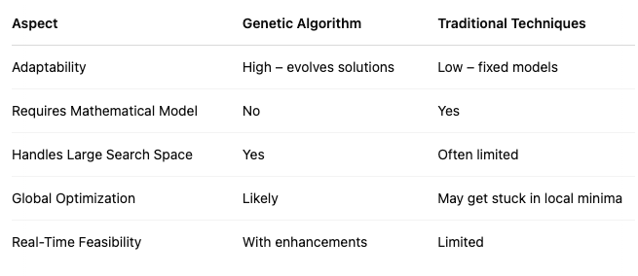
GA vs Traditional Optimization Techniques

Slide 8
Methodology
The project employs a simulation-based optimization approach to enhance traffic signal performance at a four-way intersection.
The entire methodology revolves around integrating a Genetic Algorithm with a traffic simulator (SUMO – Simulation of Urban MObility) to model and improve traffic flow.
The traffic environment is constructed using SUMO’s configuration files, which define the road network, traffic routes, and simulation scenarios.
The core idea is to treat the green light durations of traffic signals as variables to be optimized.
Each potential solution, or “individual” in the Genetic Algorithm, represents a unique set of signal timings across the intersection.
The Genetic Algorithm starts with an initial population of such individuals and evolves them over multiple generations using operations such as selection, crossover, and mutation.
The fitness of each individual is evaluated based on real-time traffic parameters obtained from the SUMO simulation, such as average waiting time, total number of vehicles passed, and queue lengths.
Solutions with better fitness are selected for the next generation, gradually leading to an optimal or near-optimal signal timing configuration.
This evolutionary strategy allows the system to explore a wide range of possible solutions and converge on the one that best improves traffic efficiency.

Slide 9
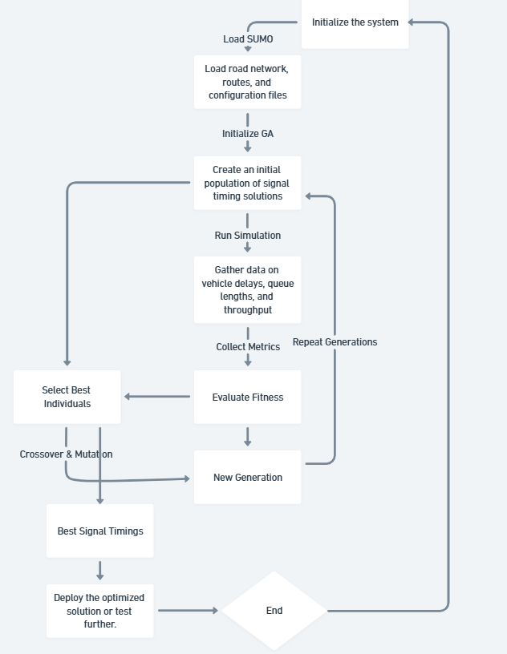
Flowchart

Slide 10
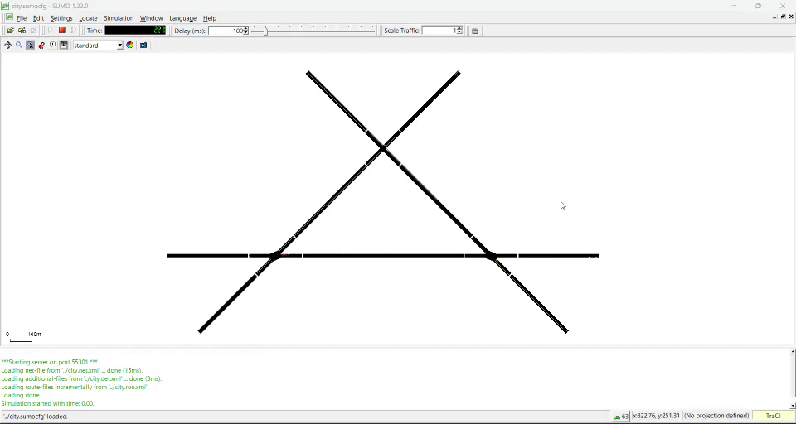
Implementations

Slide 11
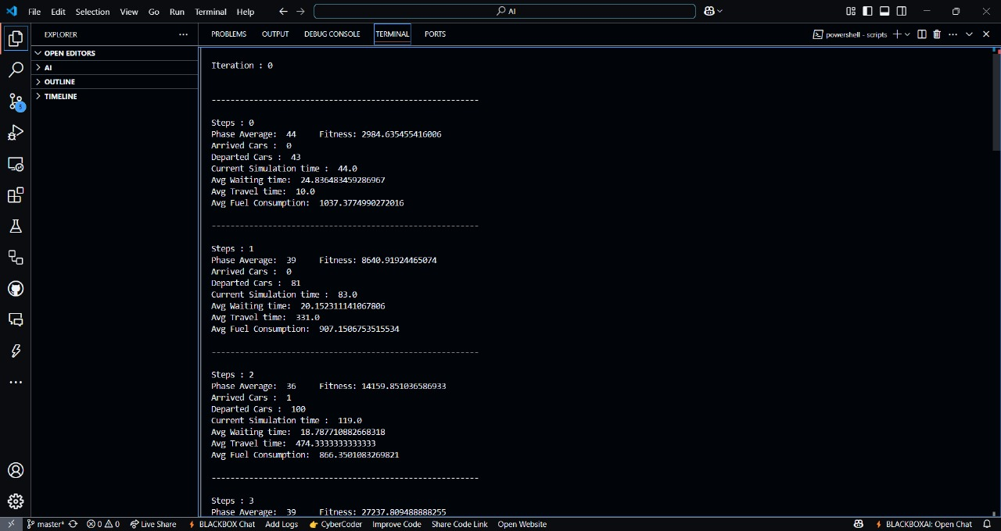
Implementations

Slide 12
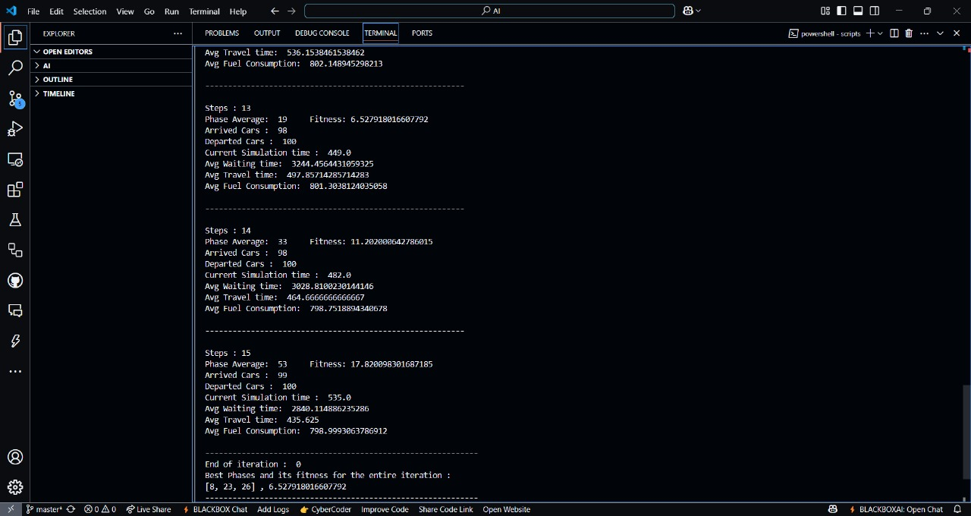
Implementations

Slide 13
Iterations
Step | Phase Average | Fitness | Arrived Cars | Departed Cars | Simulation Time | Avg Waiting Time | Avg Travel Time | Avg Fuel Consumption
0 | 44 | 2984.64 | 0 | 43 | 44.0 | 24.84 | 10.0 | 1037.38
1 | 39 | 8640.92 | 0 | 81 | 83.0 | 20.15 | 331.0 | 907.15
2 | 36 | 14159.85 | 1 | 100 | 119.0 | 18.79 | 474.33 | 866.35
3 | 39 | 27237.81 | 6 | 100 | 158.0 | 2425.27 | 548.0 | 832.88
4 | 25 | 15363.06 | 8 | 100 | 183.0 | 3869.82 | 651.20 | 835.16
5 | 49 | 795.94 | 46 | 100 | 232.0 | 5950.35 | 848.0 | 833.33
6 | 23 | 308.19 | 57 | 100 | 255.0 | 6477.72 | 901.71 | 828.07
7 | 20 | 10.29 | 59 | 100 | 275.0 | 5669.32 | 824.63 | 826.86
8 | 30 | 11.52 | 76 | 100 | 305.0 | 5040.94 | 741.33 | 819.57
9 | 27 | 10.54 | 77 | 100 | 332.0 | 4538.16 | 682.40 | 810.98
10 | 34 | 12.48 | 82 | 100 | 366.0 | 4126.57 | 626.18 | 804.90
11 | 44 | 15.18 | 92 | 100 | 410.0 | 3783.55 | 577.0 | 803.28
12 | 20 | 6.92 | 97 | 100 | 430.0 | 3493.28 | 536.15 | 802.15
13 | 19 | 6.53 | 98 | 100 | 449.0 | 3244.46 | 497.86 | 801.30
14 | 33 | 11.20 | 98 | 100 | 482.0 | 3028.81 | 464.67 | 798.75
15 | 53 | 17.82 | 99 | 100 | 535.0 | 2840.11 | 435.63 | 799.00

Slide 14
Conclusion
Genetic Algorithms offer a powerful, flexible approach for optimizing traffic signal timings.
The project successfully demonstrates that GA can reduce waiting time and improve flow at intersections.
Integrating GA with a traffic simulator like SUMO provides a realistic platform to evaluate and fine-tune signal strategies.
While this is a simulation-based model, it provides a strong foundation for developing real-time, adaptive traffic systems.
Future extensions could include:
Real-time traffic data integration using sensors or IoT devices.
Multi-objective optimization (e.g., emissions, fuel consumption).
Applying Reinforcement Learning alongside GAs for hybrid approaches.

